Slide 1

Real-Time Anomaly Detection
Distributed Processing with Flume, Spark, and Attention-Augmented Neural Networks
Big Data Analytics Project Final Report
AP25122060002-N Praveen
AP25122060031-K Pardhu Sankar
1

Slide 2


EXECUTIVE SUMMARY
•
Objective: Detect anomalies in real-time time-series data using a scalable, distributed architecture.
•
Mechanism: Integrated Apache Flume for ingestion, HDFS for storage, and Spark for parallel processing.
•
Innovation: Deployed a novel model combining CNN, BiLSTM, and Multi-Head Attention.
•
Outcome: Successfully processed 67 data files, identifying 33 "Elite" datasets with high-accuracy detection.
2

Slide 3




PRESENTATION ROADMAP
1. Infrastructure
2. Processing
3. Intelligence
4. Results
Data Ingestion via Flume & HDFS
Distributed Spark Architecture
Novel Deep Learning Model
Performance Metrics & Visuals
3

Slide 4
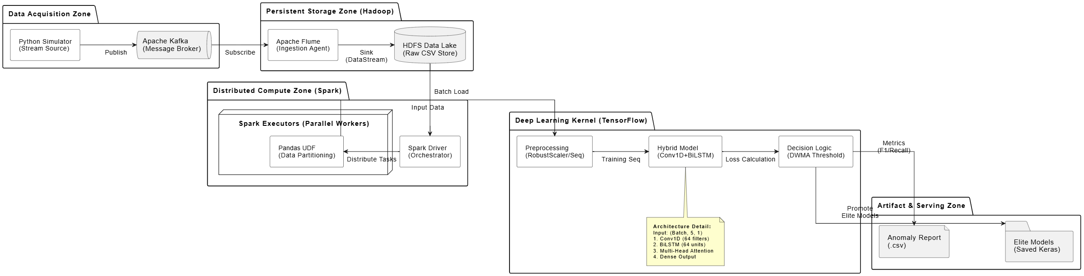
PRESENTATION ROADMAP
2. Processing
3. Intelligence
4. Results
Novel Deep Learning Model
Performance Metrics & Visuals
3

Slide 5

Section 1
Infrastructure & Data Ingestion
4

Slide 6
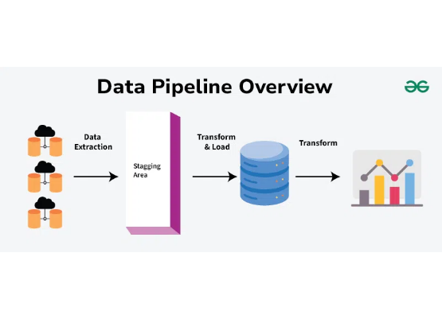
DATA INGESTION PIPELINE
The system establishes a robust pipeline to simulate real-time web server traffic and route it efficiently to distributed storage.
•
Source: Python Web Server Simulation (Port 44444).
•
Agent: Apache Flume (Netcat Source).
•
Sink: Hadoop Distributed File System (HDFS).
5

Slide 7

ROLE OF APACHE FLUME
Apache Flume acts as the critical bridge between the raw data source and the storage layer.
•
Reliability: Ensures no data loss during transmission.
•
Buffering: Uses a memory channel to handle throughput spikes.
•
Decoupling: Separates the generation of data from its processing and storage.
6

Slide 8
FLUME CONFIGURATION DETAILS
Component | Type | Parameter | Value
Source (r1) | Netcat | Bind / Port | localhost / 44444
Sink (k1) | HDFS | Path | /user/praveen/bda_project...
Channel (c1) | Memory | Capacity | 1000 Events
Format | DataStream | Write Format | Text
7

Slide 9
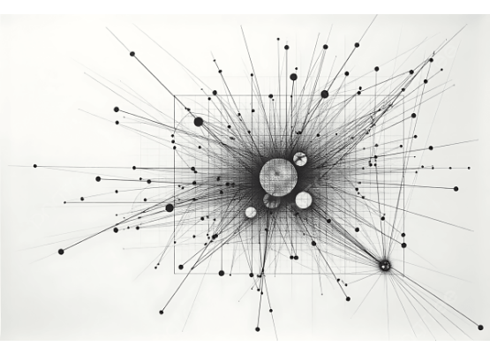
SIMULATING WEB TRAFFIC
A Python script mimics a live web server by streaming CSV data rows to a network socket.
•
Input: `real_1.csv` (Sample dataset).
•
Socket Connection: `socket.AF_INET` streaming to localhost:44444.
•
Latency Simulation: `time.sleep(0.05)` ensures a realistic data arrival rate.
•
Format: Streamed as comma-separated strings (timestamp, value, anomaly).
8

Slide 10

Real-Time Data Flow
Web Server Script ↓ TCP Socket (Port 44444) ↓ Flume Netcat Source ↓ Memory Channel ↓ HDFS Sink
9

Slide 11

SYSTEM VERIFICATION
Validation Steps Performed
•
Local Validation: Confirmed 100 samples saved to `local_100_sample.csv`.
•
Flume Connection: Verified successful socket connection and data stream.
•
HDFS Inspection: Used `hdfs dfs -ls` to confirm file creation.
•
Data Integrity: `hdfs dfs -cat` verified the content format matches the source.
10

Slide 12
Section 2
Distributed Processing with Spark
11

Slide 13
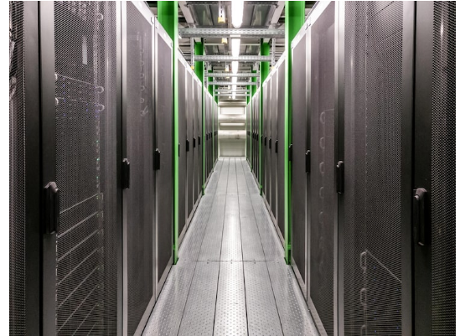
SPARK ENVIRONMENT SETUP
The processing core utilizes Apache Spark 4.0.1, optimized for local parallel processing.
•
Java Runtime: Forced configuration of Java 17 (OpenJDK).
•
Memory Allocation: 4GB Driver / 4GB Executor to handle intensive Deep Learning tasks.
•
Optimization: Apache Arrow enabled (`spark.sql.execution.arrow.pyspark.enabled`) for efficient data transfer between JVM and Python.
12

Slide 14


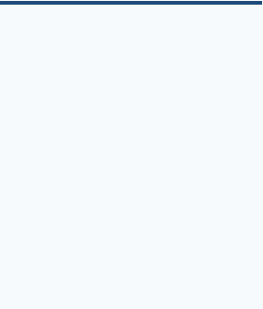

HDFS DATA INGESTION
Source Path
Bulk Load
File Tagging
Reading from `/user/praveen/bda_project/Yahoo_S5_Data/A1Benchmark`
Spark automatically ingests all CSV files within the directory simultaneously.
`input_file_name()` is used to tag each row with its source filename.
13

Slide 15
SCHEMA DEFINITION & CLEANING
Data integrity is enforced through strict typing and null handling before processing begins.
Cleaning Actions
•
Casting: Explicit type casting ensures consistency across heterogeneous files.
Field | Type | Notes
timestamp | Double | Time series index
value | Double | Metric reading
anomaly | Integer | Ground truth (0 or 1)
•
Renaming: `is_anomaly` standardized to `anomaly`.
•
Null Removal: `df_spark.na.drop` removes corrupted rows to prevent training errors.
•
Volume: Total 94,866 rows loaded from 67 files.
14

Slide 16

THE SPLIT-APPLY-COMBINE STRATEGY
Instead of sequential looping, Spark distributes the workload across available cores.
•
Split: The massive DataFrame is grouped by `file_source`.
•
Apply: A Pandas UDF (`analyze_one_file`) processes each file independently.
•
Combine: Results (F1 scores, metrics) are aggregated back into a single results DataFrame.
15

Slide 17
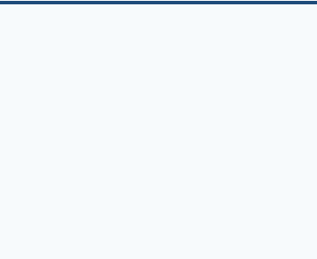
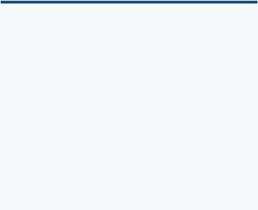
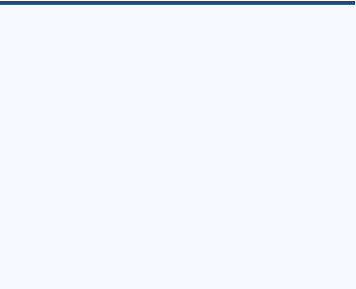
WHY DISTRIBUTED PROCESSING?
Speed
Isolation
Scalability
Reduced total processing time to 877 seconds for 67 deep learning models.
Data leakage is impossible as each file is processed in its own isolated memory space.
Architecture supports scaling to thousands of files simply by adding more nodes.
16

Slide 18
Section 3
The Intelligence Engine
17

Slide 19
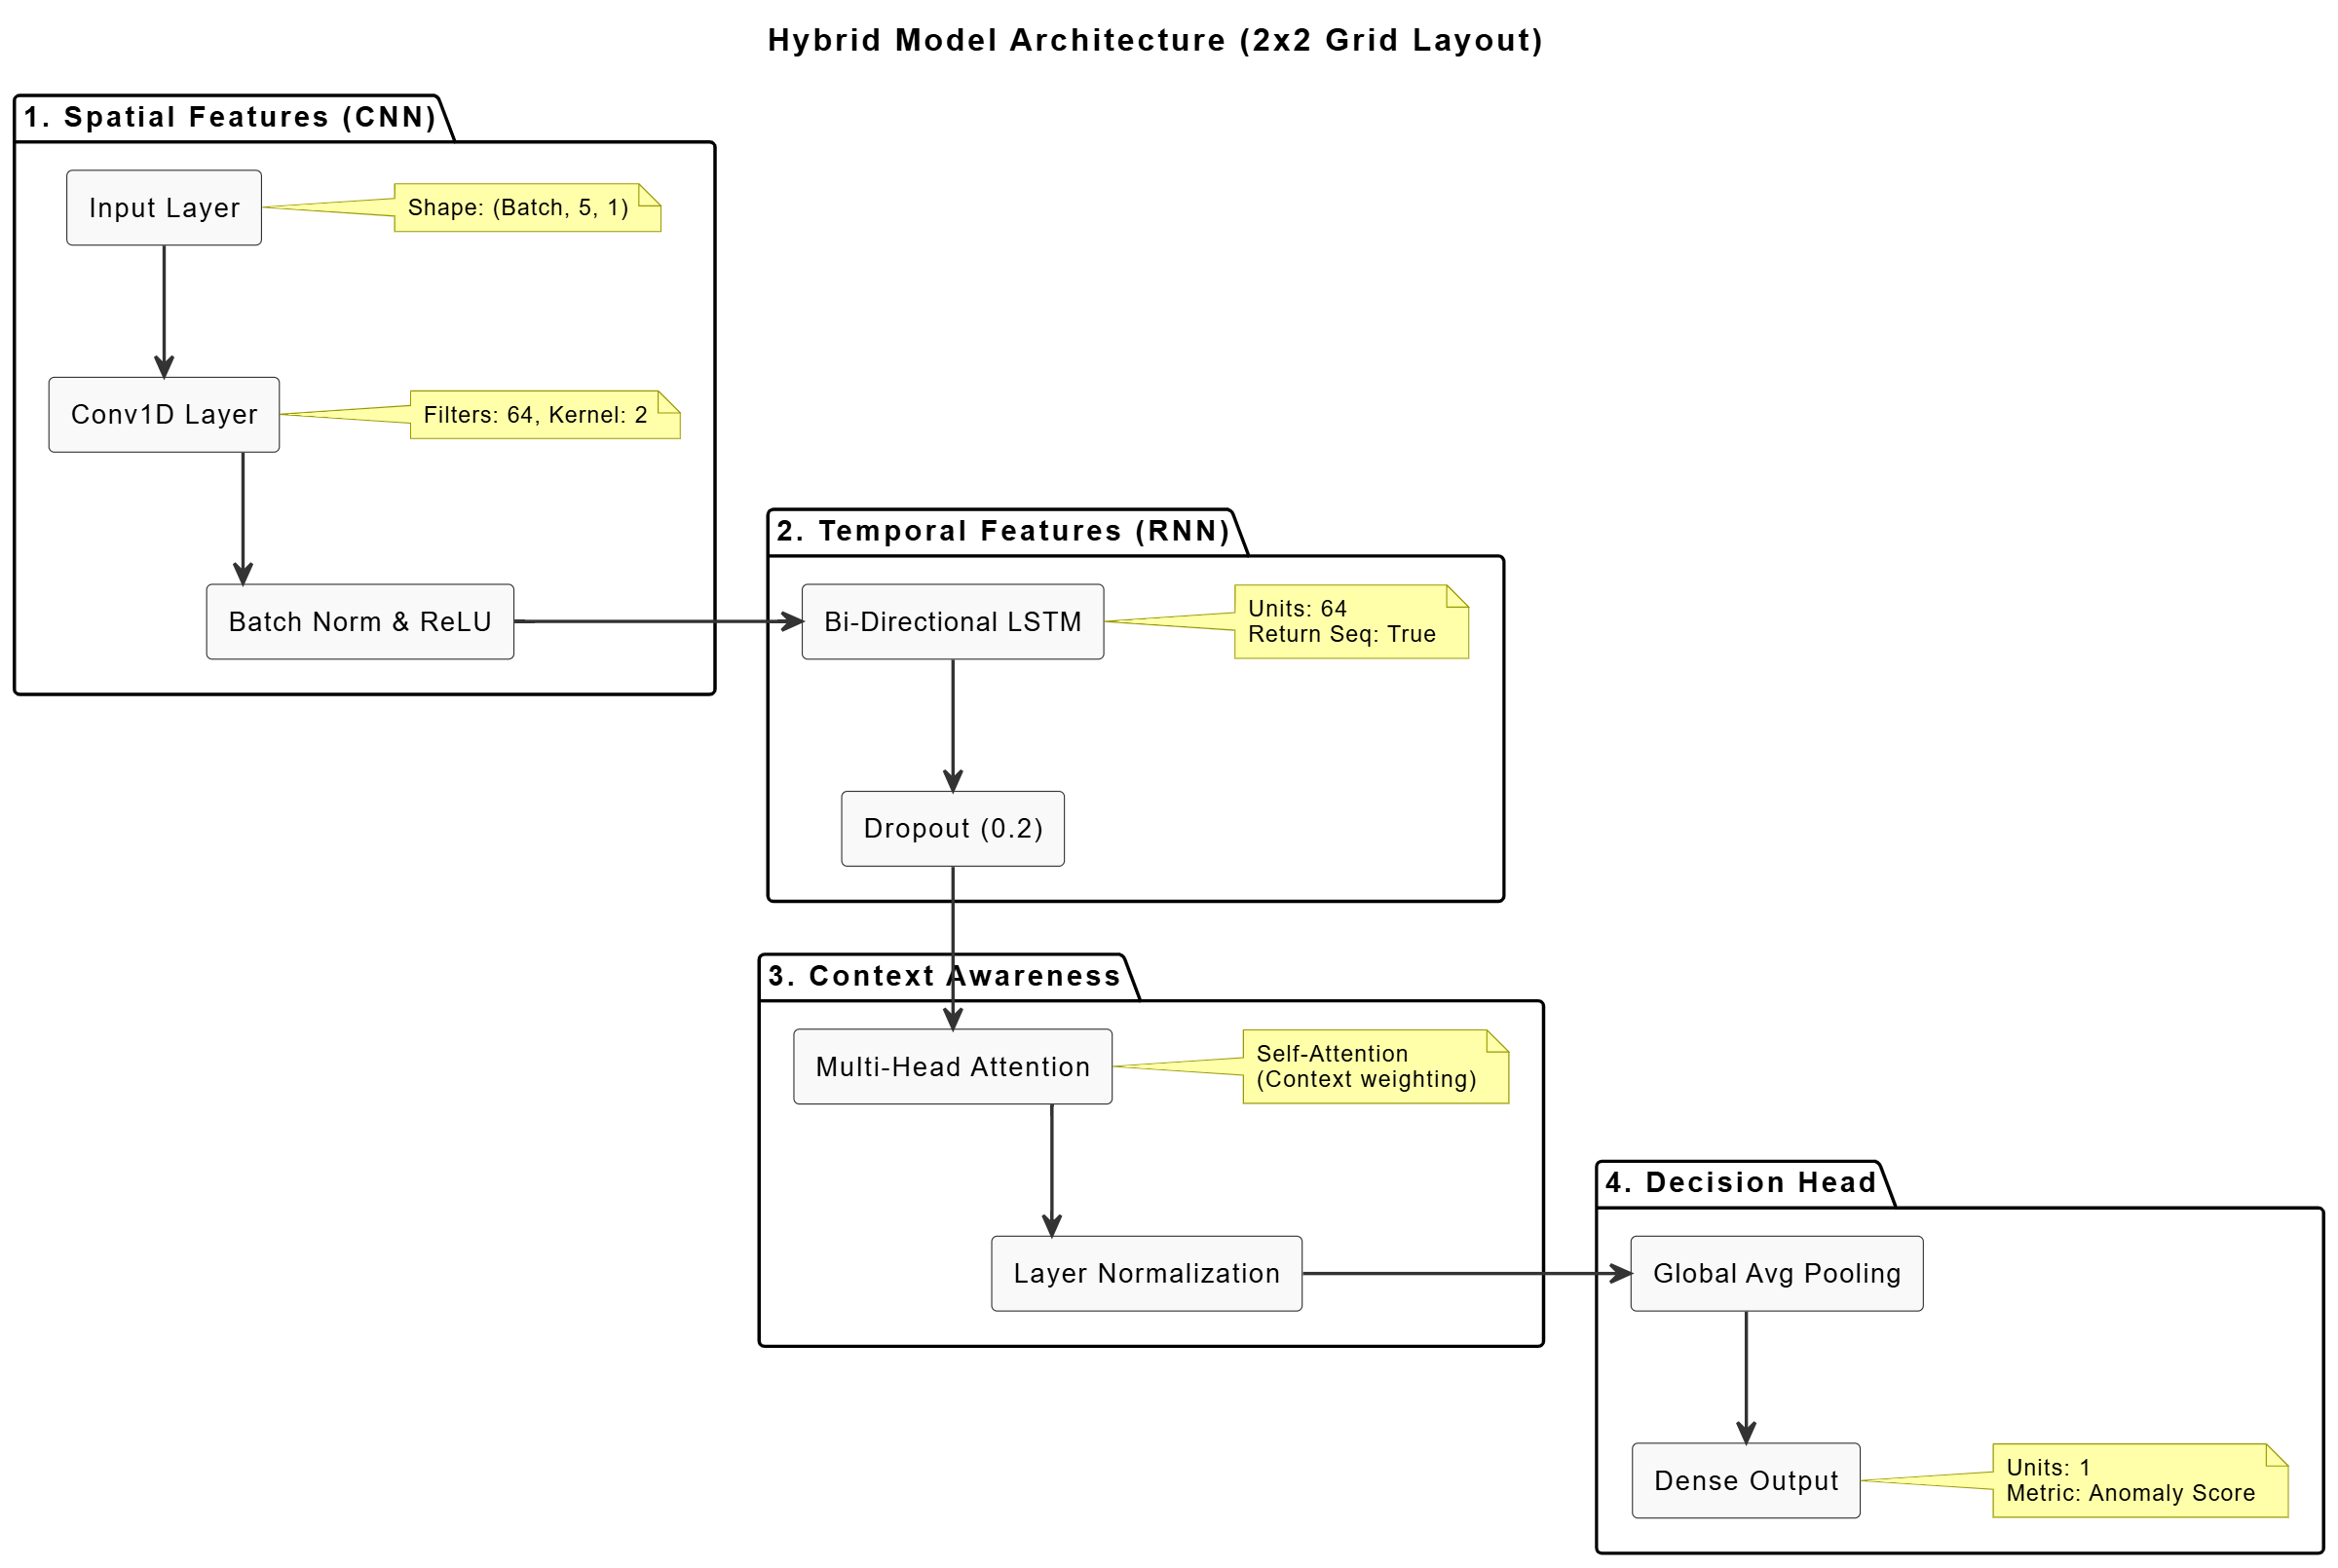
THE MODEL
.
18

Slide 20


THE MODEL
A hybrid deep learning architecture designed for temporal anomaly detection.
•
Input: Sequence of 5 time steps.
•
Features: Spatial (CNN) and Temporal (LSTM).
•
Focus: Self-Attention mechanism to weight critical time steps.
18

Slide 21

LAYER 1: FEATURE EXTRACTION (CNN)
Conv1D + MaxPool
The first stage extracts local patterns and reduces noise.
•
Filters: 64 filters with a kernel size of 3.
•
Activation: ReLU for non-linearity.
•
Pooling: MaxPooling1D reduces dimensionality and emphasizes dominant features.
•
Goal: Identify sudden spikes or drops in the local window.
19

Slide 22

LAYER 2: TEMPORAL CONTEXT (BILSTM)
Bidirectional LSTM
Captures long-term dependencies in both forward and backward directions.
•
Units: 64 units per direction (128 total output).
•
Bidirectionality: Allows the model to understand the context of a data point based on past and future (within the sequence) trends.
•
Dropout: 0.2 dropout rate applied to prevent overfitting on smaller datasets.
20

Slide 23
LAYER 3: MULTI-HEAD ATTENTION
Focus
Relevance
Integration
Dynamically assigns weights to different time steps in the sequence.
Helps the model distinguish between random noise and significant signal deviations.
Output is added to the original features (Residual connection) and normalized.
21

Slide 24
ROBUST DATA PREPROCESSING
Decontamination
RobustScaler
Training data is strictly decontaminated. Anomalies in the training set are masked and interpolated to prevent the model from learning "bad behavior" as normal.
Unlike standard scaling, `RobustScaler` uses the median and interquartile range (IQR). This makes the model resilient to outliers, which are frequent in anomaly detection tasks.
22

Slide 25
EWMA DYNAMIC THRESHOLDING
A static threshold fails in dynamic environments. We implemented an Exponential Weighted Moving Average (EWMA) strategy.
•
Safety Net: A "Noise Floor" (99th percentile of training error) prevents the threshold from dropping too low during quiet periods.
•
Adaptability: The threshold adjusts automatically to the rolling volatility of the signal.
23

Slide 26
Section 4
Performance & Results
24

Slide 27

EXECUTION METRICS
Efficiency at Scale
The distributed Spark job demonstrated high efficiency, processing a complex deep learning pipeline across dozens of files.
877.84s
Total Execution Time
67
Files Processed

Slide 28
PERFORMANCE SCORECARD
33
34
Elite Files
Weak Files
F1 Score ≥ 0.6
F1 Score < 0.6
26

Slide 29
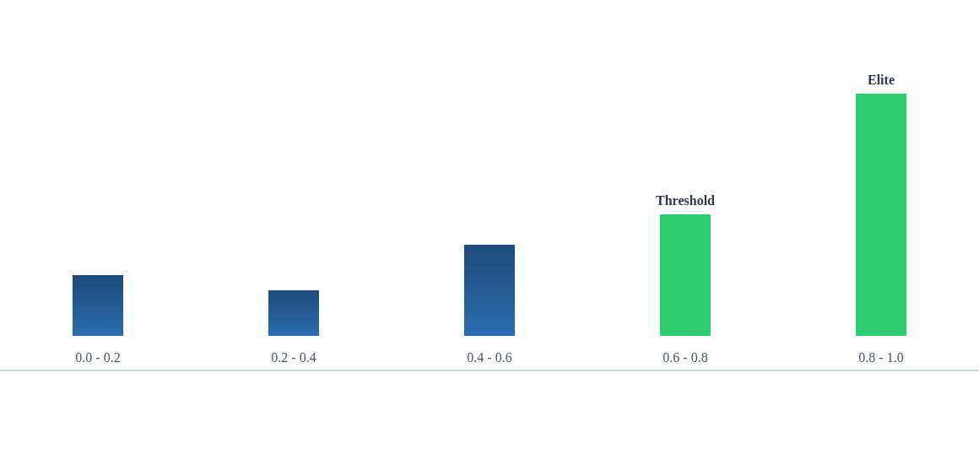
F1 SCORE DISTRIBUTION
Histogram showing the polarization of model performance across datasets.
27

Slide 30
TOP "ELITE" PERFORMERS
File Name | F1 Score | Status
real_11.csv | 1.00 | ELITE
real_17.csv | 1.00 | ELITE
real_15.csv | 1.00 | ELITE
real_22.csv | 1.00 | ELITE
real_10.csv | 0.90 | ELITE
28

Slide 31
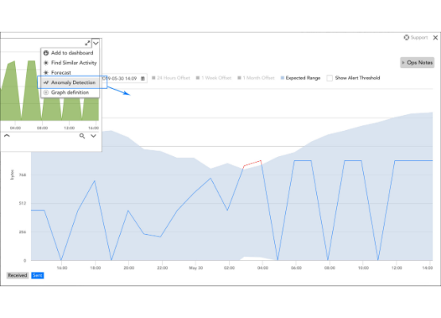
CASE STUDY: REAL_17.CSV
Perfect Detection
The model achieved an F1 Score of 1.00 on `real_17.csv`.
•
Signal: Clean baseline with distinct anomalies.
•
Prediction: The model successfully flagged all anomalies without false positives.
•
Visual: Red dots (predictions) align perfectly with green zones (ground truth).
29

Slide 32
PROJECT CONCLUSION & ARTIFACTS
Key Deliverables
•
Models: 33 Elite Keras models saved to local disk and HDFS.
•
Data: `final_anomaly_results.csv` containing metrics for all 67 files.
•
Impact: Demonstrated a scalable, leakage-free pipeline for real-time industrial anomaly detection.
30

